Slide 1
Creating Data Visualizations with Python
Winter 2022

Slide 2
Housekeeping
In case of technical problems:
Something wrong on my end (e.g. power outage), I will send you an email.
Something wrong on your end, please send me a text message. 508-769-6446
jcodygroup@gmail.com
We have 4 hours for each session
I will try to give you an opportunity to stand and stretch every hour.
We will take at least one 15-minute break near the halfway point.

Slide 3
About me
Experience:
25+ years consulting and training experience
Extensive work with “big data” and analytics
15 years working with various data visualization tools
Education
Ed. M., Technology, Innovation & Education, Harvard University
PhD Candidate, Education Policy, University of Massachusetts, Amherst

Slide 4
Learning Objective
Knowledge, skillsets, mindsets
Knowledge of:
A variety of python data visualization packages
The structure of visualizations
Package documentation
Skillsets:
The ability to produce basic plots with some formatting using matplotlib & seaborn
Mindsets:
Think, sketch before coding
Note: We will be focusing on plotting. We will not be doing any data manipulation to prepare for plotting.

Slide 5
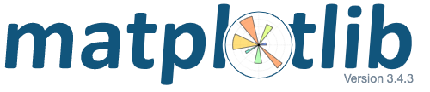
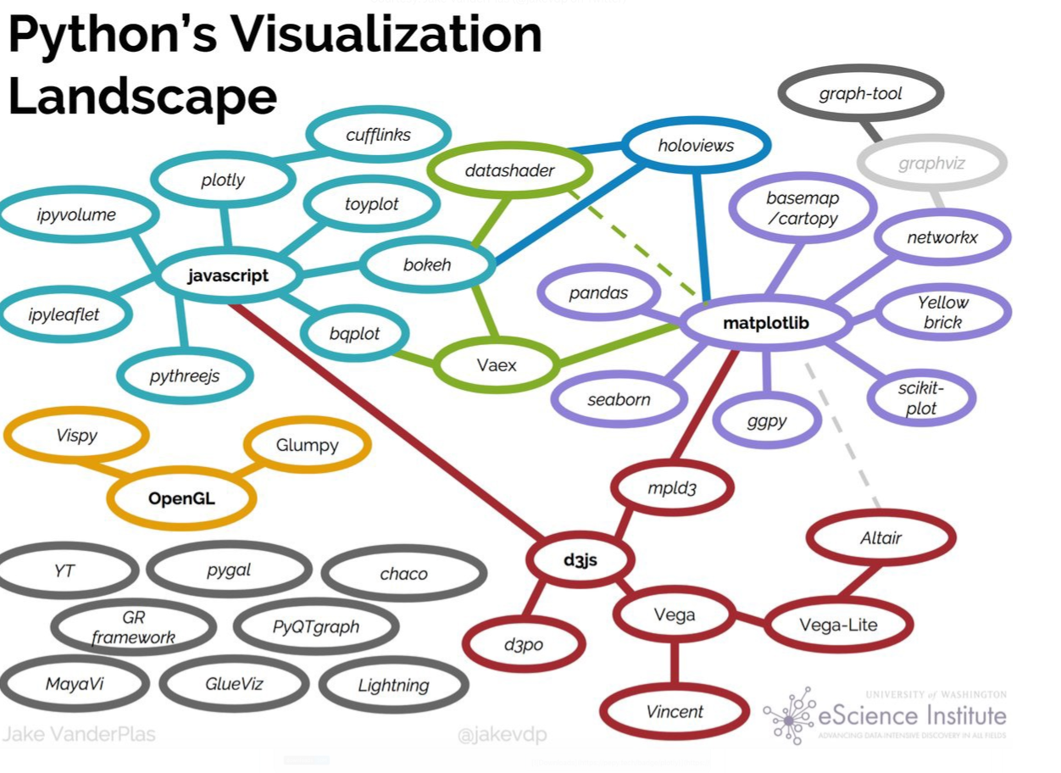




Slide 6
‘Workhorse’ data & visualization packages
pandas
(dataframes)
seaborn
numpy
(arrays)
matplotlib
supports

Slide 7
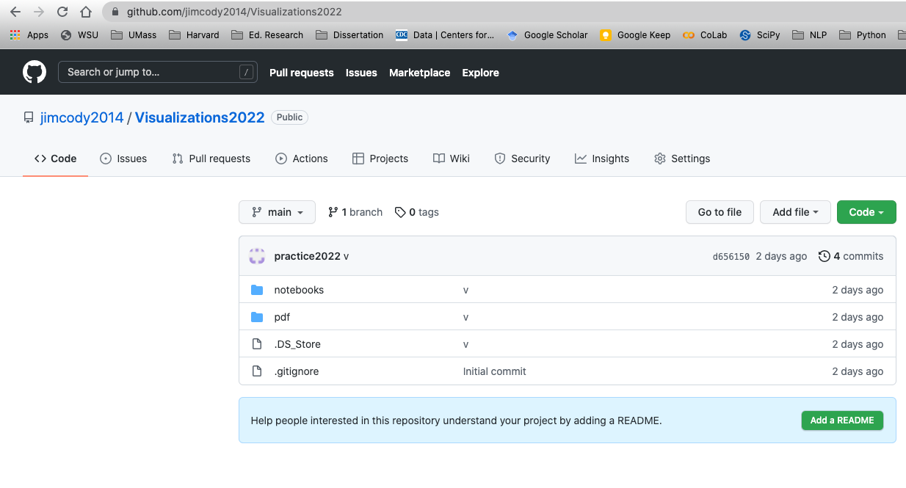
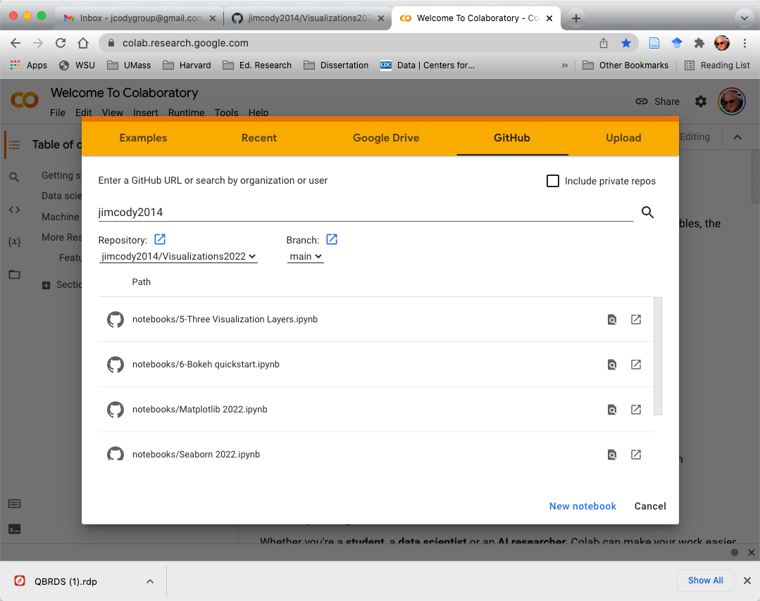
Accessing jupyter notebooks for class
git push
Jim’s Desktop

Slide 8
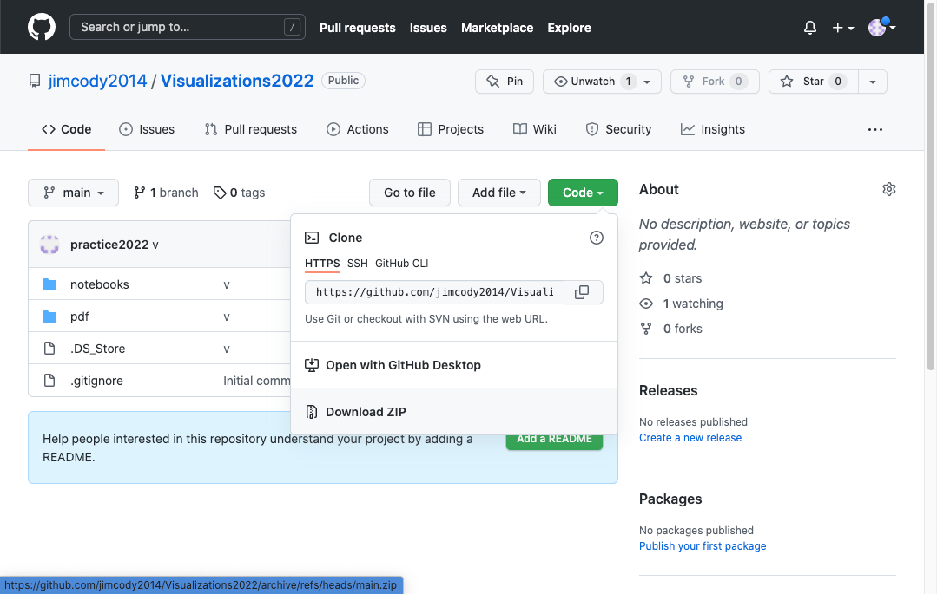
You can also download from github (this is optional!)

Slide 9
Matplotlib

Slide 10
Matplotlib
Matplotlib is a popular Python package used to build plots.
It was started as a project in the early 2000's to replicate MATLAB's plotting capability with Python.
Matplotlib has three interfaces (ways to write code)
pyplot – hides the complexity of object-oriented coding.
object-oriented – provides access to more functions and control over the visualizations
pylab (not recommended for use)
This lesson covers the pyplot and object-oriented interfaces

Slide 11
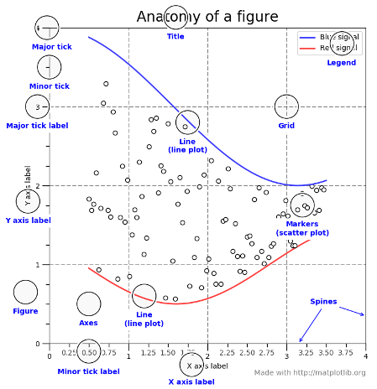
Two big concepts to keep in mind
Figure
Axes
Plot
Figure
Axes
Plot 1
Plot 2
Figure
Axes
Axes
Plot 1
Plot
Plot 2

Slide 12
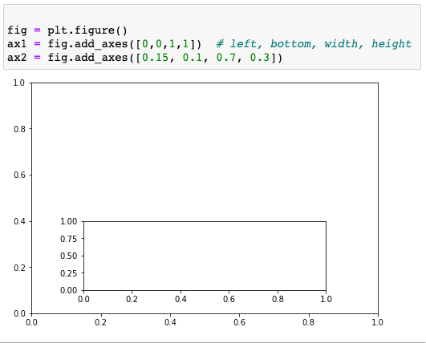
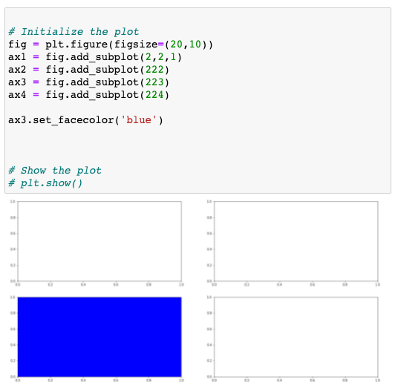
Adding axes
fig.add_axes: for absolute positioning
fig.add_subplot: for grid positioning

Slide 13
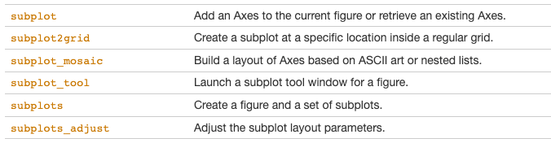
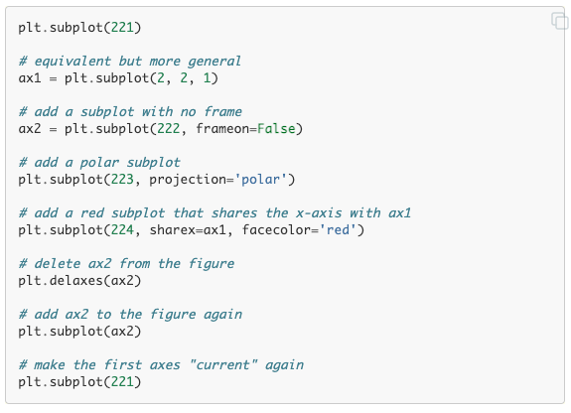
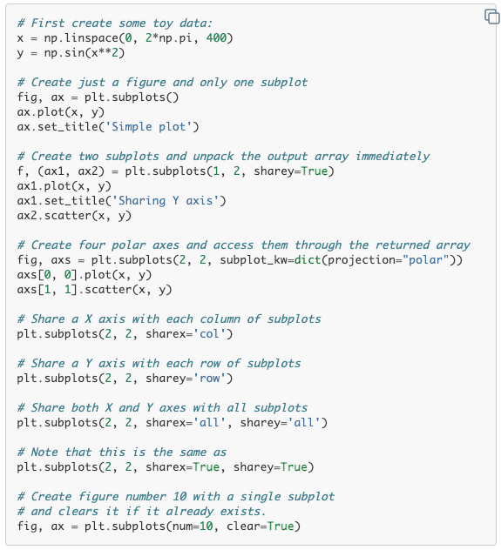
Subplots using pyplot
from the documentation
from the documentation

Slide 14
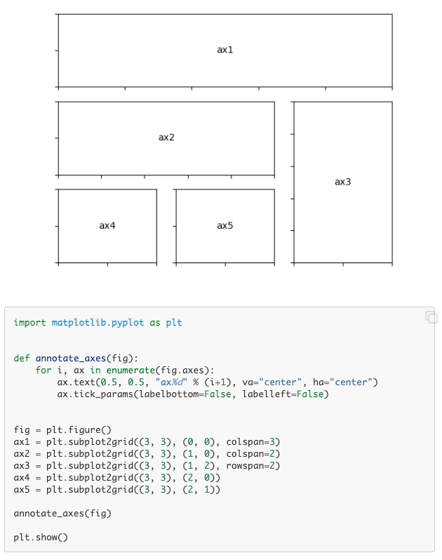
Subplots using pyplot
from the documentation

Slide 15
Seaborn

Slide 16
Seaborn
Seaborn is a library for making statistical graphics in Python.
It builds on top of matplotlib and integrates closely with pandas data structures.
Seaborn plotting functions operate on dataframes and arrays containing whole datasets and internally perform the necessary semantic mapping and statistical aggregation to produce informative plots.
Its dataset-oriented, declarative API lets you focus on what the different elements of your plots mean, rather than on the details of how to draw them.

Slide 17
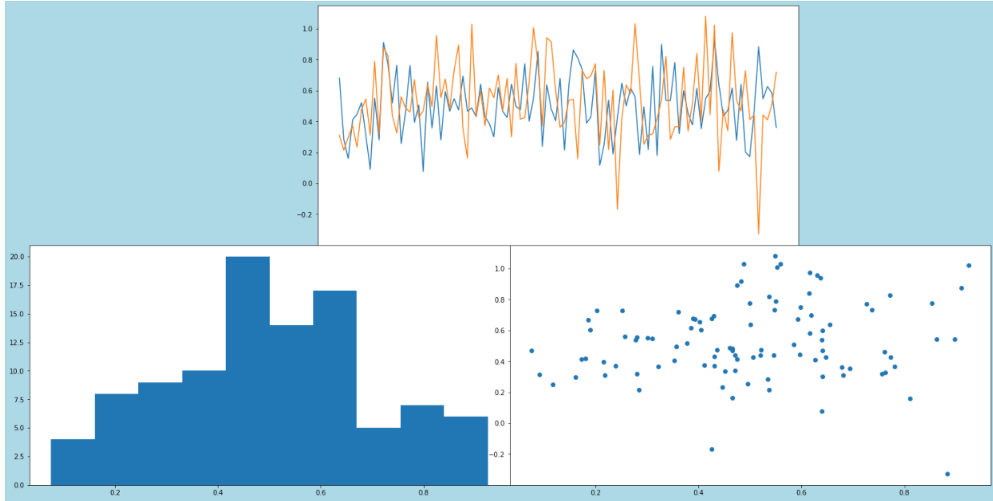
Day 2 Warm-up. 8:30 – 8:55
In CoLab, open the notebook named Day 2 Warm-up.
The imports and data are already in place.
Recreate the figure shown here.
Improve the figure
Add legends
Make sure there is a little space between each plot
Add titles to each plot
Add a figure level title
On the scatterplot, use:
change the size of the mark based on duration
change the color of the mark based on the disease
(diseases are just numbers 1-4)
Is it better to indicate the disease by shape?
Add any other labels, titles, etc. that you think might clarify what is being shown.
Save the figure as a png. Download it to your machine.
Lineplots of illness & hospitalizations
Histogram of illness
Scatterplot of illness & hospitalization
Suggestion: Create each visual separately and then create a figure that holds all three.
Use the notebook from yesterday as reference. You will also need to use the matplotlib documentation.

Slide 18
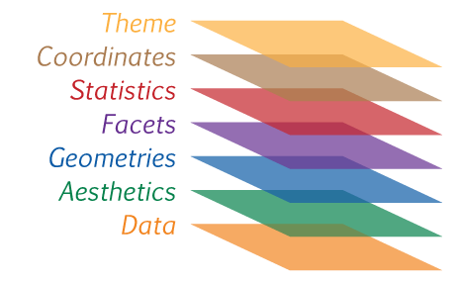
Grammar of Graphics

